Slide 1
Simple Demo Projects using Spring Boot
Spring MVC
Spring Boot One-to-One Mapping
Spring Boot RESTFUL web services

Slide 2
Movie Tickets (using Spring MVC)
Create a ticket booking service:
Create an online ticket booking service and save entries into the database.
Implementation details:
Create a Ticket class pojo. Add the required fields. Annotate with @Entity and @Table.
Create a TicketController class. Map to the Ticket create view. Allow the user to enter details (movie name, seat# and screen#). Save the details into DB using TicketsRepository class and show successful message.
Create a Create Ticket view. Add a form for entering movie details (movie name, seat# and screen#).

Slide 3
Code Snippet
@Entity
public class Ticket {
@Id
@GeneratedValue(strategy = GenerationType.IDENTITY)
private int id;
private String movie;
private String screen;
private String seat;
…Getters, Setters
--------------------------------------------------------------------------------------------------------------------------------------------------------------
@Controller
public class TicketController {
@Autowired
TicketsRepository ticketrepo;
@RequestMapping("/showCreateTicket")
public String showCreateTicket() {
return "createTicket";
}
@RequestMapping("/createTicket")
public String createTicket(Ticket ticket, ModelMap modelMap) {
ticketrepo.save(ticket);
modelMap.addAttribute("msg","Ticket purchased successfully");
return "createTicket";
}
------------------------------------------------------------------------------------------------------------------------------------------------------------------View
<title>Create Ticket</title>
</head>
<body>
<form action="createTicket" method="post">
Movie Name: <input type="text" name="movie"/>
Screen: <input type="text" name="screen"/>
Seat No: <input type="text" name="seat"/>
<input type="submit" value="purchase"/>
</form>
${msg}
</body>

Slide 4
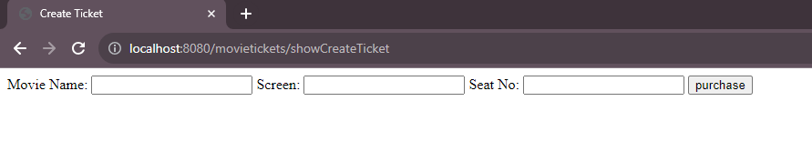
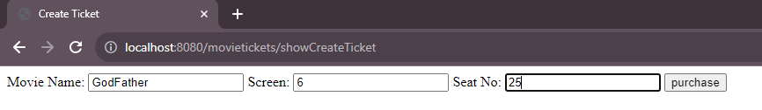
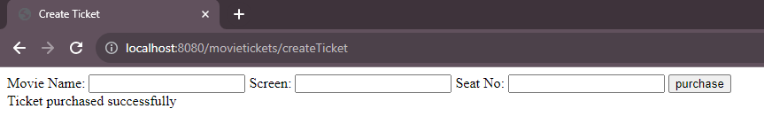
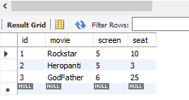
Result

Slide 5
Spring Boot One-to-One Mapping
Use case: Create 2 tables User(id, name, email) and User_Profile(id, phone number, address, gender) and use 1-1 mapping.
Implementation details:
1)Create User class and it’s corresponding fields; annotate with @Entity @Table(name="users")
2) Create User class and it’s corresponding fields; annotate with @Entity @Table(name="user_profiles")
3)Use @OneToOne and @JoinColumn and do a bi-directional mapping.

Slide 6
Code Snippet
@Entity @Table(name="users") public class User { @Id @GeneratedValue(strategy=GenerationType.IDENTITY) private long id; @Column(name="name") private String name; @Column(name="email") private String email; @OneToOne(fetch = FetchType.LAZY, cascade= CascadeType.ALL) @JoinColumn(name="up_id") private UserProfile userProfile; | @Entity @Table(name= "user_profiles") public class UserProfile { @Id @GeneratedValue(strategy=GenerationType.IDENTITY) private long id; @Column(name="phone_number") private String phoneNumber; @Column(name="address") private String address; @Column(name="gender") private String gender; @OneToOne(fetch=FetchType.LAZY, cascade=CascadeType.ALL,mappedBy = "userProfile") private User user;
//SpringBootOneToOneMappingApplication class
public void run(String... args) throws Exception {
User user = new User();
user.setName("Chaya");
user.setEmail("chaya@gmail.com");
UserProfile up = new UserProfile();
up.setAddress("Bangalore");
up.setGender("F");
up.setPhoneNumber("1234567890");
user.setUserProfile(up);
up.setUser(user);
userRepository.save(user);
}

Slide 7


Result

Slide 8
Spring Boot RESTFUL web services
Demonstrate REST APIs with MySQL for User Management
Create User REST API
Get User By Id REST API
Implementation details:
Create User Entity and create corresponding fields (id, first_name, last_name, email) for user.
Create User Service interface for a) Saving user details and b) to get user by id.
Create User Service implementation for defining 2) save user into DB b) to retrieve user information from DB
Create User Repository to do auto CRUD operations
Create REST User Controller using @RestController annotation,

Slide 9
Code Snippet
@Data @Entity @Table(name="users") public class User { @Id @GeneratedValue(strategy = GenerationType.IDENTITY) private long id; @Column(nullable = false) private String first_name; @Column(nullable = false) private String last_name; @Column(nullable = false,unique = true) private String email; }
---------------------------------------------------------------------------Service Interface
public interface UserService { User createUser(User user); User getUserById(Long userId); }
---------------------------------------------------------------------------- Service Implementation class
@Service @AllArgsConstructor public class UserServiceImpl implements UserService { @Autowired private UserRepository userRep; @Override public User createUser(User user) { return userRep.save(user); } @Override public User getUserById(Long userId) { Optional<User> optionalUser = userRep.findById(userId); return optionalUser.get(); } }

Slide 10
Code Snippet
Rest Controller
@RestController @AllArgsConstructor @RequestMapping("api/users") public class UserController { @Autowired private UserService userService; //build create user REST API @PostMapping public ResponseEntity<User> createUser(@RequestBody User user){ User savedUser = userService.createUser(user); return new ResponseEntity<>(savedUser, HttpStatus.CREATED); } //Build getUSerById REST API //http:localhost-8080/api/users/1 @GetMapping("{id}") public ResponseEntity<User> getUserById(@PathVariable("id") Long userId){ User userById = userService.getUserById(userId); return new ResponseEntity<>(userById,HttpStatus.OK); } }

